Slide 1

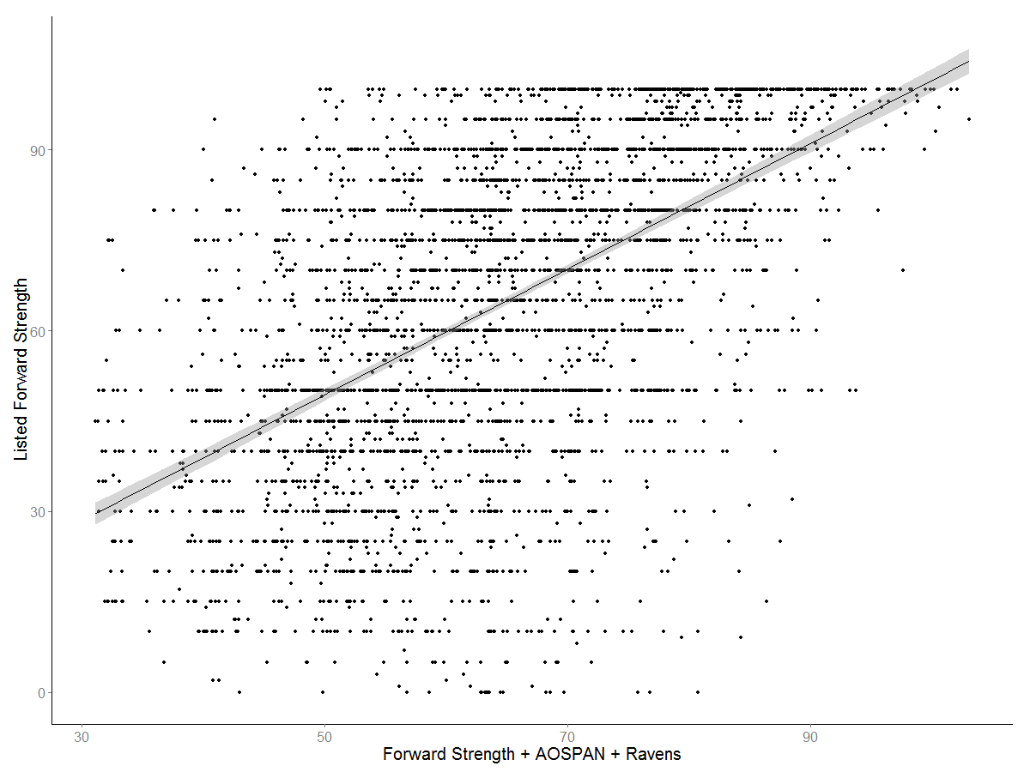
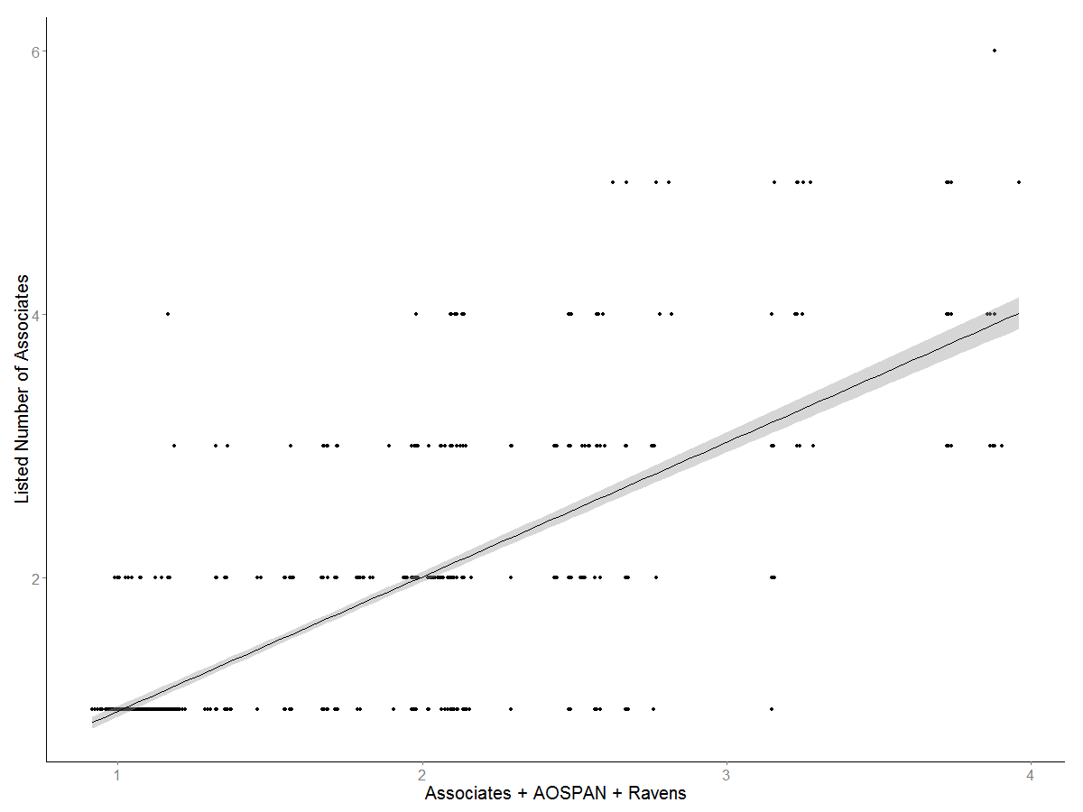
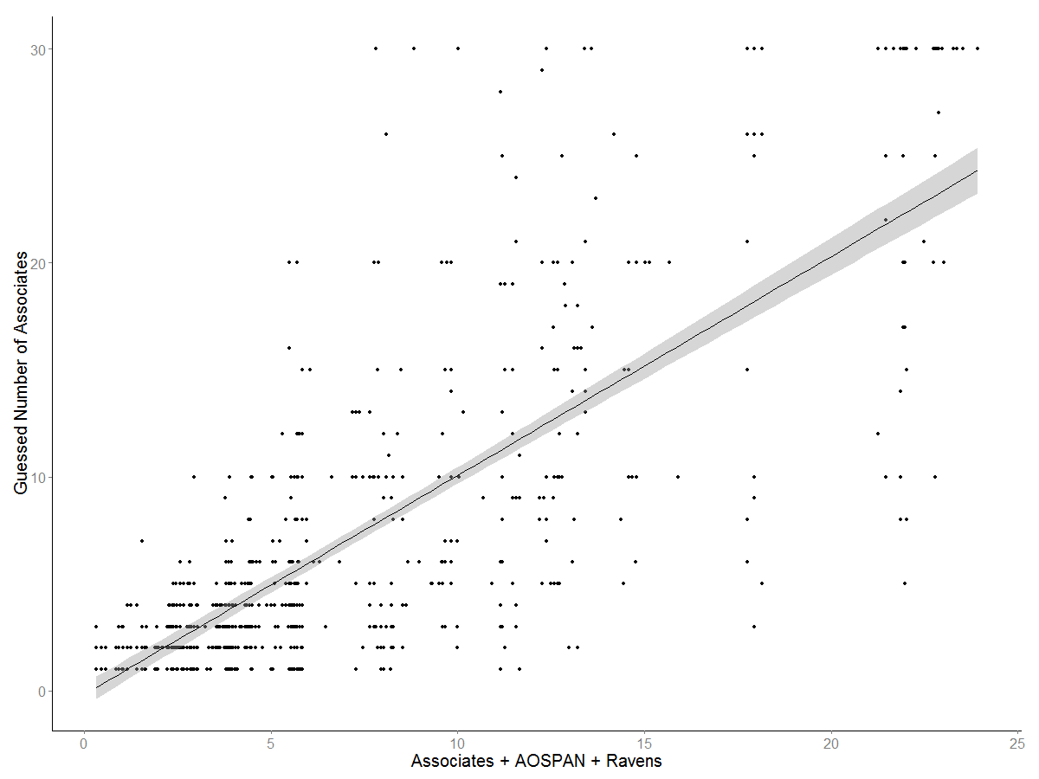
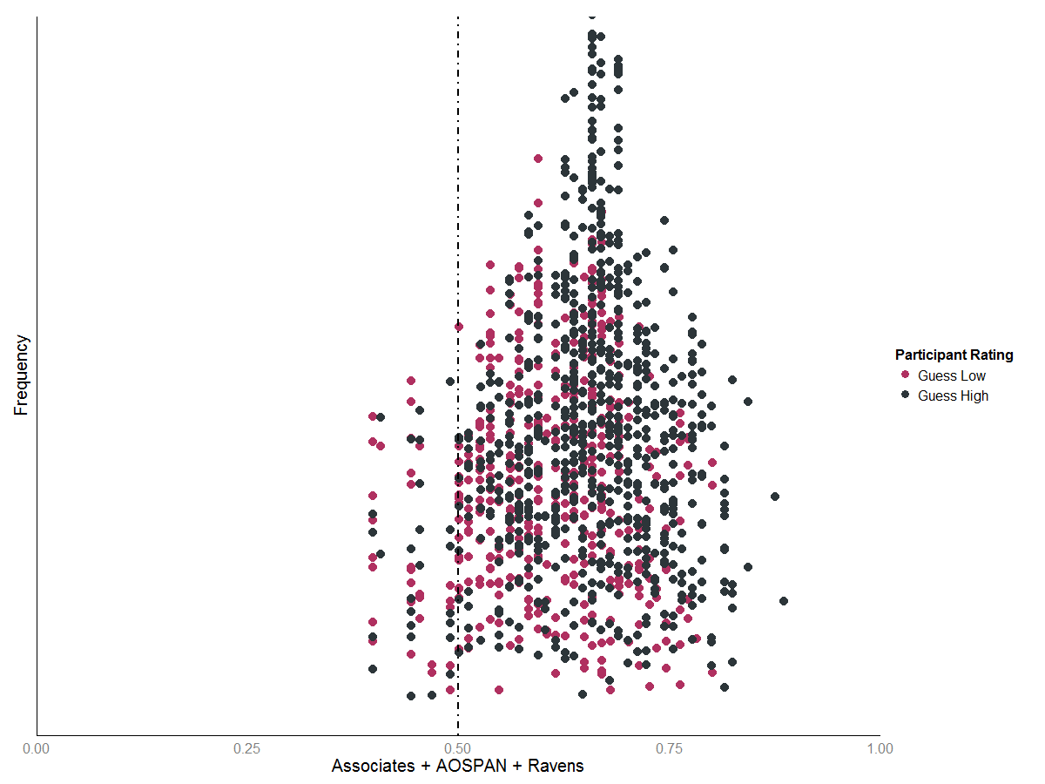
Understanding JAM: How Judgment of Association
is Influenced by Working Memory and Fluid Intelligence
Erin M. Buchanan, Ph.D., Katherine D. Miller, Emily R. Klug
Department of Psychology, Missouri State University, Springfield, MO
ABSTRACT
RESULTS and DISCUSSION
Four different groups were tested in variations of the Judgments of Memory task created by Maki (2007a). Participants judged word pairs on the strength of their relationship, performed a free association task (Nelson, McEvoy, & Schreiber, 2004), and judged how many words were related to a given cue word. As seen with Maki (2007a; 2007b), participants had difficulty discriminating between word pairs with low and high relationships. This finding was extended to show that people also could not free associate word pairs with different numbers of associates, or even judge how many associates a cue word is linked to in memory. However, participants’ judgment ability varied widely in each one of the tasks. Working memory and fluid intelligence were measured in order to examine metacognitive errors and had an interactive influence on participant ability to judge word pair relationships.
METHODS
Experiment 1.
Database score was a significant predictor, suggesting that as the number of associates increased, they were able to accurately predict a higher number of associates.
We found a significant interaction between database score, fluid intelligence, and working memory.
Experiment 3.
Database score was again significant predictor which was qualified by a significant three-way interaction between database, fluid intelligence, and working memory.
Participants.
A total of 133 participants were tested from Texas Tech University and the University of Mississippi.
Experiment 1 (N = 44), Experiment 2 (N = 25), Experiment 3 (N = 26), Experiment 4 (N = 38).
Materials.
Words and word pairs for judgments were drawn from the University of South Florida Free Association Norms.
We used words with varying levels of associative strength and numbers of associates.
All participants took the AOSPAN and Raven’s Progressive Matrices
Method.
Experiment 1.
CHEESE-CHEDDAR
How many college students out of 100 would write the SECOND cue word to the FIRST target word?
Experiment 2.
CHEESE
Write down as many related words as you can think of, but remember that the words have different numbers of related words.
Experiment 3.
CHEESE
How many number of words are related to the given target word?
Experiment 4.
CHEESE
Does this target word have a low or high number of associates?
Experiment 2.
Database score, fluid intelligence, and working memory were all significant predictors – as these scores increased, participant ratings increased, except for OSPAN scores, which showed a negative relationship between rating and working memory.
Experiment 4.
Database was the only significant predictor of the dichotomous judgments.
Questions? Contact Erin Buchanan (erinbuchanan@missouristate.edu)
Notes:
1

